Slide 1
Memory Demo – Moonwalking With Einstein http://booksforpsychologyclass.weebly.com/

Slide 2
Misconception: If we cannot say what we know, it is not in our memory.
Counterintuitive Concepts in AP Psychology
Counterintuitive Finding: We have both declarative and non-declarative memories.
1. Declarative Memory: Information that you can tell others about
2. Non-Declarative Memory: Information that you can demonstrate by doing something.

Slide 3
Directions: Each slide will be presented for 4 seconds. Please refrain from talking during the task.

Slide 7
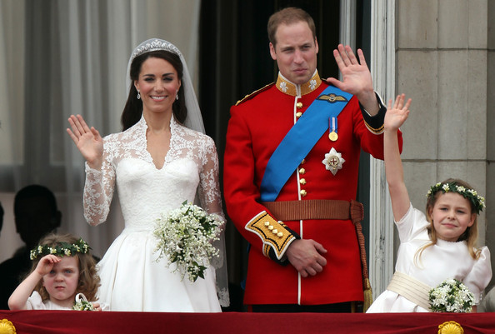

Slide 34
Moonwalking with Einstein
1. What are the 5 largest cities in Texas?
2. What is the official name for the hashtag symbol?
3. How many folds are in a chef’s hat (white, tall and pleated) and why?

Slide 35
Moonwalking with Einstein
What are the 5 largest cities in Texas?
Houston, San Antonio, Dallas, Austin, and Fort Worth
2. What is the official name for the hashtag symbol?
Octothorpe (8 point and from Old English for village looks like a village surrounded by 8 fields)
3. How many folds are in a chef’s hat (tall pleated white hat) and why?
100 because it symbolizes their level experience – the number of ways to prepare an egg.

