Slide 1
Henrietta Lacks
(1920-1951)

Slide 2
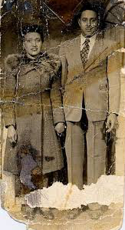
Henrietta Lacks (the Person) 1920-1951
Born and raised on a tobacco farm in Virginia.
Died of aggressive cervical cancer at age 31.
Left behind a husband and four children.
Died at John Hopkins Medical Center in Baltimore, MD.

Slide 3
Henrietta Lacks (her cells)
Before she died a biopsy of cells from her cervix were taken without her knowledge.
These cells became known as HeLa cells.
HeLa cells have been used to create a polio vaccine, research treatments for AIDS, cancer, gene mapping, and many other ailments.

Slide 4
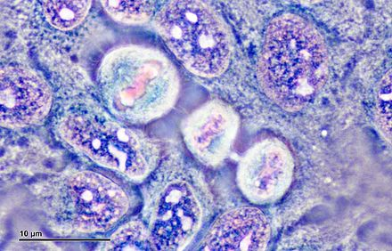
Henrietta Lacks (ethical questions)
Neither Henrietta nor her family members gave permission for her cells to be removed.
Questions for Consideration
Who owns the cells that are removed from biopsies or other cells that are removed from patients?
If the patient dies, is it necessary to gain permission from family members to use the cells?
If patients have to give permission, will this limit the progress of science?
Who should profit from research with human cells? How will these cells be tracked?

Slide 5
Reproduced HeLa cells today would weigh 50 million metric tons.
By the late 1950s, 6 trillion HeLa cells were produced each week.
All the HeLa cells ever grown could circle the earth three times.

Slide 6
"HeLa cells were one of the most important things that happened to medicine in the last hundred years."
-

Slide 7
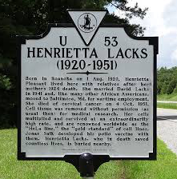
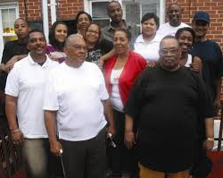
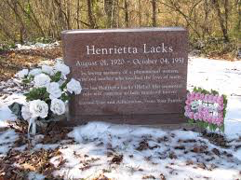
Henrietta Lacks (Legacy)
Henrietta’s family remains upset that permission to take the cells was never sought or provided but pleased to know that Henrietta’s cells have produced so many benefits.

Slide 8
Henrietta Lacks Film
2017 HBO film

Slide 9
Resources
https://www.hopkinsmedicine.org/henriettalacks/immortal-life-of-henrietta-lacks.html
https://www.npr.org/2010/12/13/132030076/henrietta-lacks-immortal-cells-live-on-in-labs
Skloot, R. (2010). The Immortal Life of Henrietta Lacks. New York, NY: Random House.
https://www.youtube.com/watch?v=XPz0bmsXp6M

