Slide 1
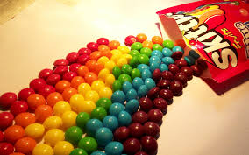
Guess How Many Skittles are in the Glass

Slide 2
Directions
For each of the following photographs, determine how many Skittles you think are in the glass. Write down your estimates, but do not say them out loud.

Slide 3
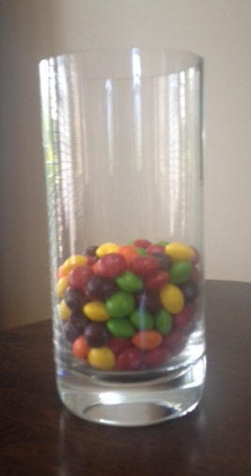
Photo #1
Notes:
182 skittles

Slide 4
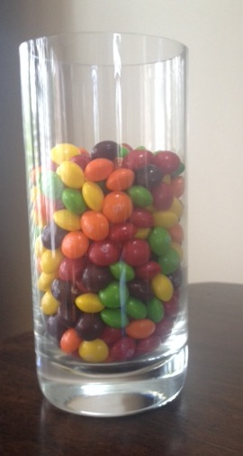
Photo #2
Notes:
333 skittles

Slide 5
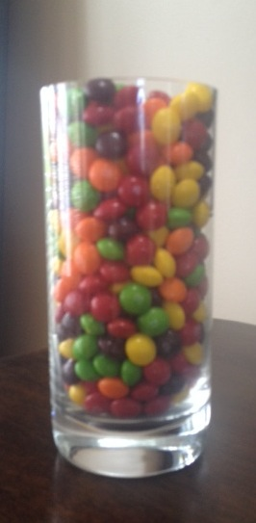
Photo #3
Notes:
492 Skittles

Slide 6
Discussion
For each of the three pictures, we will try to determine the group average and find the individual who came closest to the correct answer.

