Slide 1
Using Cognitive Science to Introduce Students to Learning that Sticks Laura Brandt and Kara Bosman Libertyville High School, Illinois
Notes:
https://drive.google.com/drive/folders/1FdLFlTh13O2xRF6gZqyHbHaYEb29MLLg
Folder for Presentation Materials: Demos/Handouts.etc. https://drive.google.com/drive/folders/1B5ttcMofiRatfAwxllUM888J5or6wBTI

Slide 2
Cognitive Psychology
The science behind understanding how the mind works, conducting empirical research into how people perceive, remember, and think.
Helps us learn and retrieve information more effectively and efficiently

Slide 3
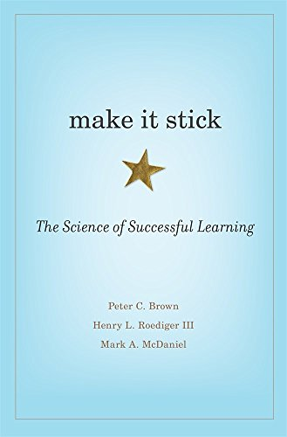
Why?
Implement best practices in teaching and learning to improve students learning experiences in our classrooms and in the long-term.

Slide 4
Lessons from Make it Stick
•Dispel myths about how students best prepare, study, and learn.
•Introduce strategies backed by cognitive science.
•Explain and share examples of strategies.
•Implement best practices.
•Reflect on your own practice.
Continual Improvement

Slide 5
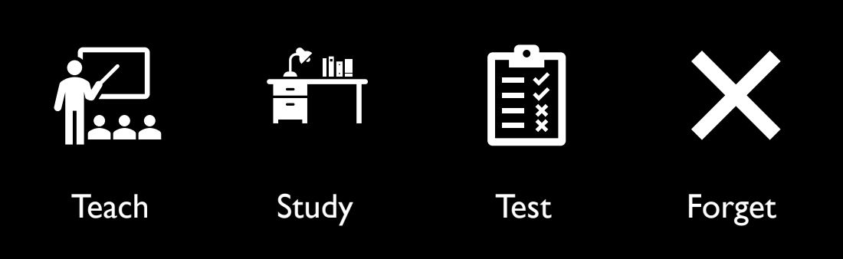
This is not what we want for our students

Slide 6
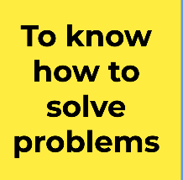
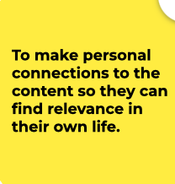
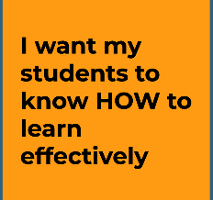
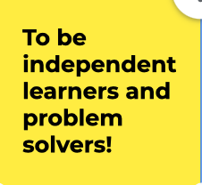
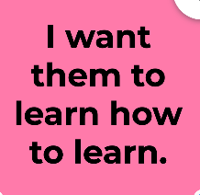
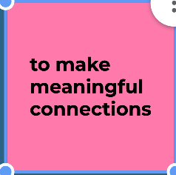
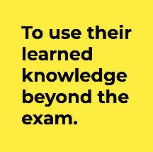
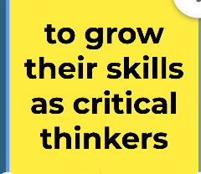
This is what we want for our students
All Comments taken from instructors at Libertyville High School

Slide 7
Generation
Reflection
Elaboration

Slide 8
A Quick Introduction to Neuroscience
How does information make it into memory?

Slide 9
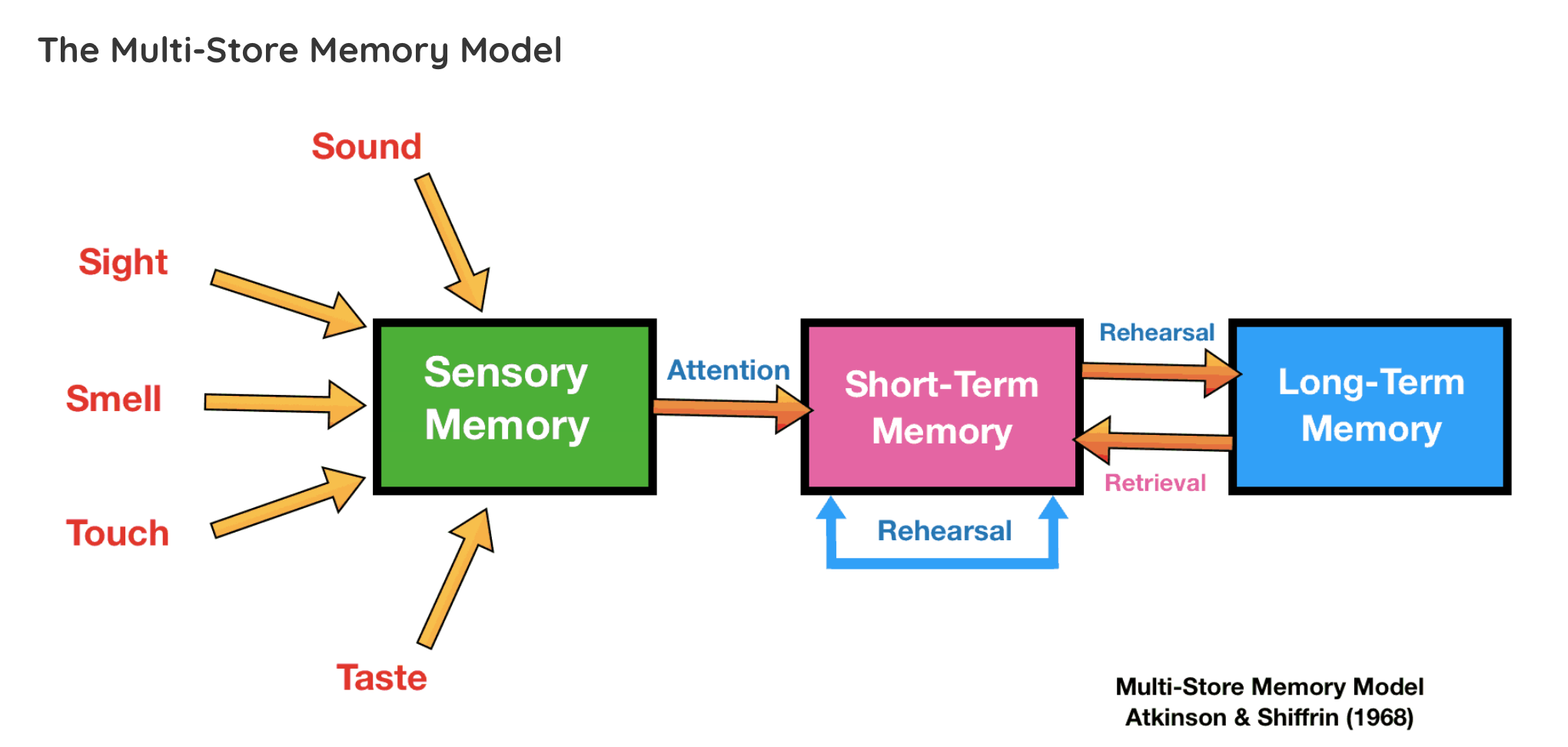
Multi-Store Model of Memory

Slide 10
Cognitive Strategies Preview
Interleaving/ Varied Practice
Metacognition
Levels of Processing
1
3
5
2
4
6
Retrieval Practice/ Testing Effect
Serial Position Effect
Distributed Practice

Slide 11
Myth
Information discussed early in the course will be retained later.

Slide 12
1.
Interleaving/ Varied Practice
Mixing together different topics (content) or forms of practice (skill) in order to facilitate learning

Slide 13
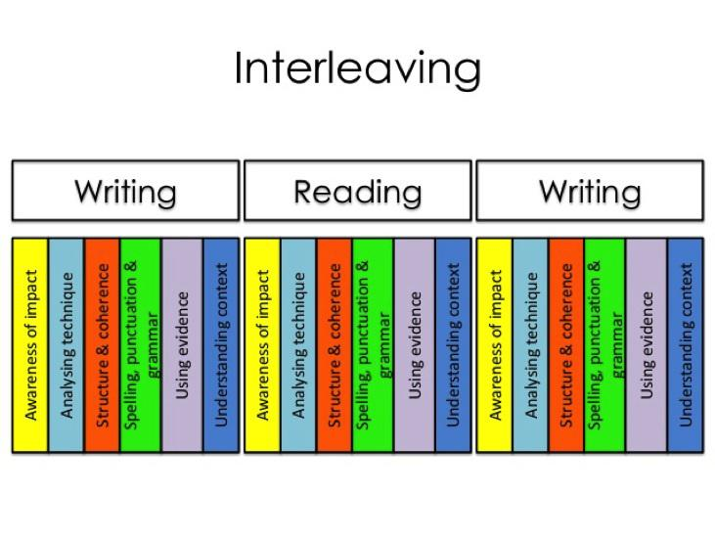

Slide 14
Interleaving
Psychology
Exams
1st Semester:
Current Chapter MCQ (30-35 questions) +1 free-response
2nd Semester:
Current Chapter MCQ (30-35 questions) + 10 Qs (1 chapter from 1st Semester) + 1 free-response

Slide 15
Interleaving
Base new learning on a foundation of prior knowledge.
Content
When we discuss memory, review to brain structures.
When we discuss disorders, review to neurotransmitters.
When we discuss treatment, review perspectives.

Slide 16
Design quizzing exercises that reach back to concepts and learning covered earlier in the term.
Notes:
Page 227

Slide 17
REFLECTION
How can you implement interleaving into the courses that you teach?

Slide 18
Myth
I know that I really understand something when the learning is easy.

Slide 19
Myth:
As long as you are doing something to prepare for the test, you will do well.

Slide 20
2.
RETRIEVAL PRACTICE/ TESTING EFFECT
We don’t want students to fool themselves into thinking they’ve learned.

Slide 21
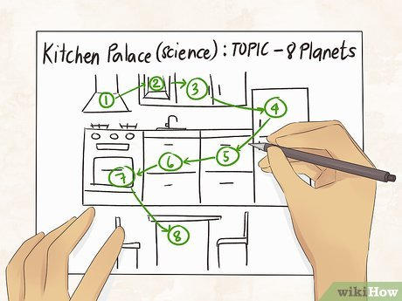
Retrieval Practice/Testing Effect
Mnemonic Devices
One Sun/Peg Word Method:An object is associated with a number (1-10) each number has a rhyming peg word and the peg word is associated with the object to be recalled.
Method of Loci: Using a location (house, school, etc.) to place object to be remembered. Good for lists of items, order or operations, names, etc.

Slide 22
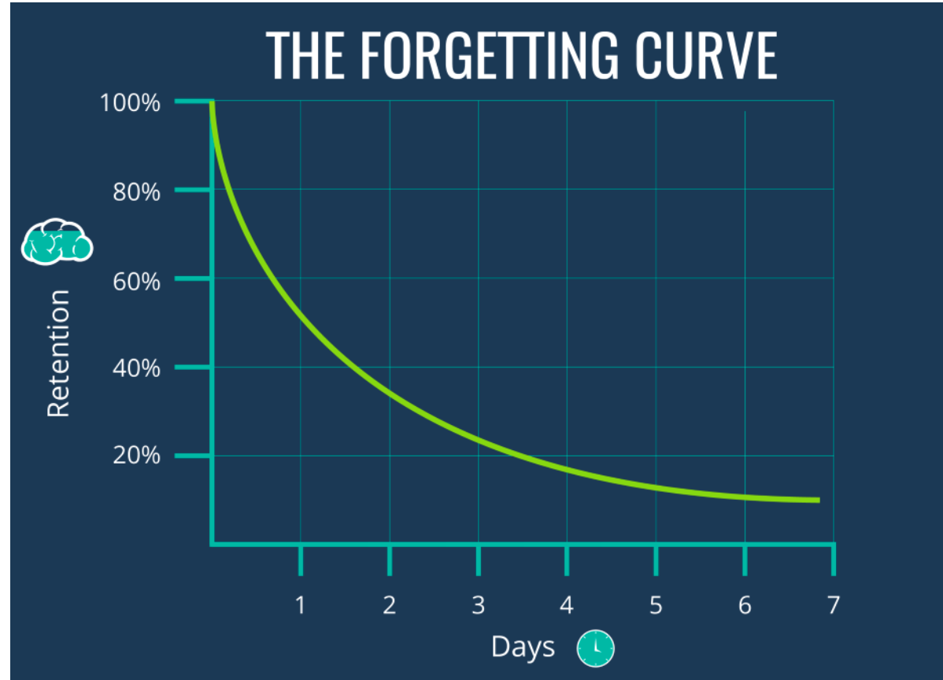
Retrieval Practice/Testing Effect
Traditional study methods

Slide 23
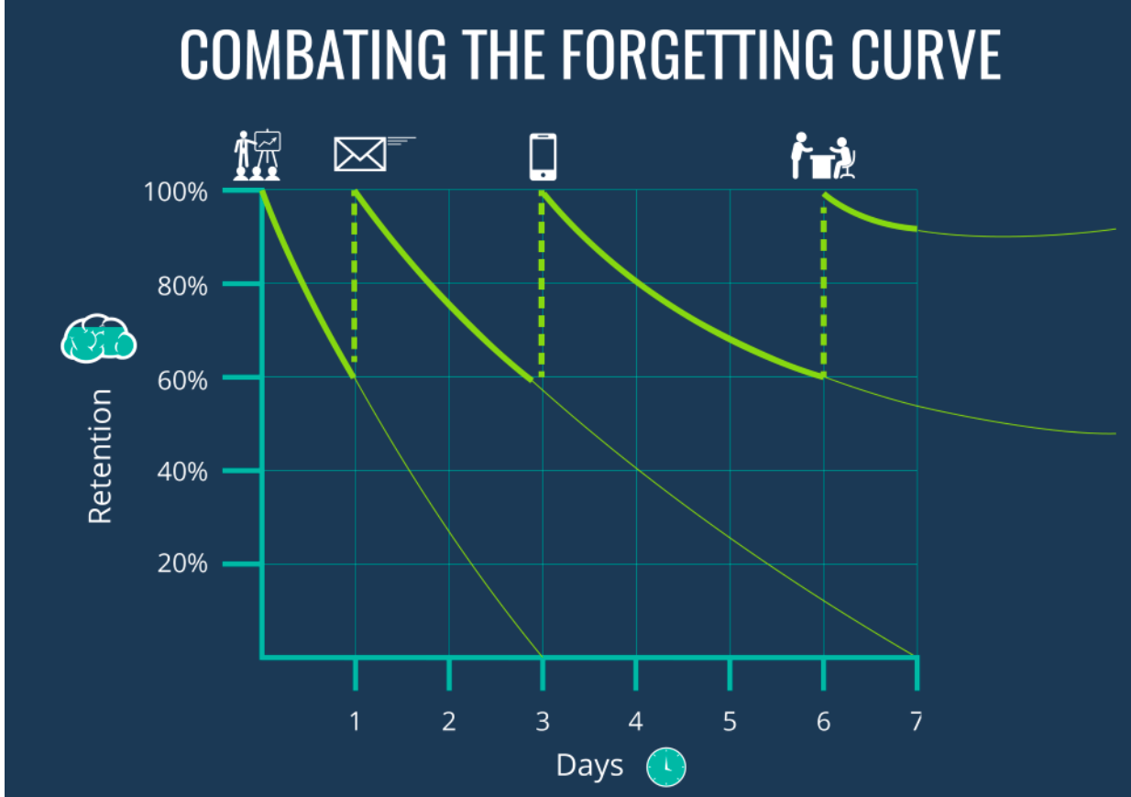
Retrieval Practice/Testing Effect
Study methods that include retrieval practice
Students scored a full letter grade higher on material that had been quizzed (pg. 35)

Slide 24
Retrieval Practice/Testing Effect
Flashcards: Practice cards beyond knowing a definition
Quizlet: https://quizlet.com/latest
Build formatives into notes.
https://docs.google.com/presentation/d/1TDXVUnZ7JThH4fPfy8D8K4dhNjlAFP-q/edit
Test in the moment
Socrative: https://www.socrative.com/#login
Pre-test and Practice Tests
AP classroom/Online test banks

Slide 25
Retrieval Practice/Testing Effect
Examples of Mnemonics
Biological Bases
PARAsympathtetic- PARAchute slows you down = REST & DIGEST
SAME
S - sensory neurons
A - afferent neurons
M - motor neurons
E - efferent neurons
Motor vs. Sensory Cortex- motor is in the front of the car
FPOT- F-Frontal, P-Parietal, O-Occipital, T-Temporal
Lobes
Frontal Lobe- when you do something dumb, you thump front of your forehead with palm of your hand
Parietal lobe is patting top of your head saying “good job.” You feel sensation because that person is hitting parietal lobe.
Occipital lobe- eyes in the back of your head
Temporal lobe- you hear the tempo of music through your ears
Broca's area- If it’s a Broca you can’t a talka (Boca is mouth in Spanish)
Hippocampus- hippocampus is like a college campus (you make a lot of memories & you learn a lot of things)

Slide 26
Retrieval Practice/Testing Effect
What can you do to improve Retrieval Practice?
•Free recall
•Testing Groups
•Summary Sheets
•Exit Questions: Paper or electronic (Google forms/Socrative)
•Self-quiz after reading
•Shoulder Partners: Explain in your own words, what we just learned and relate it to something your already know (page 222).

Slide 27
REFLECTION
How can you implement retrieval practice into the courses that you teach?

Slide 28
Myth:
I know what I don’t know.

Slide 29
3.
METACOGNITION
Awareness and understanding of one's own thought processes.

Slide 30
Making mistakes and correcting them builds bridges to advance learning.

Slide 31
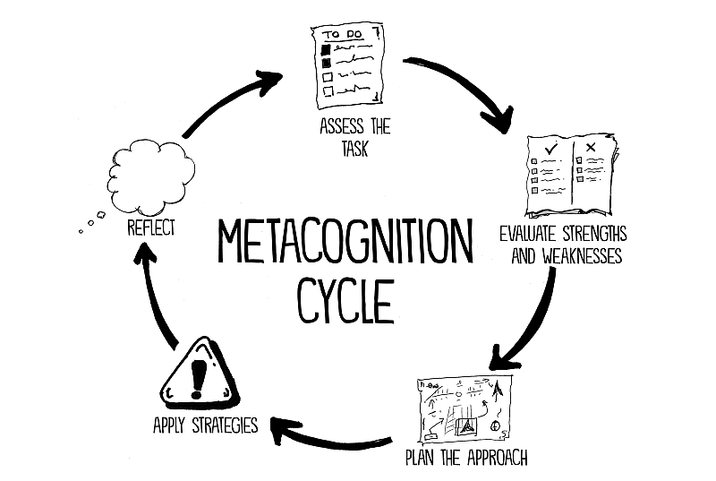
ACE form
What areas on the assessment do you think you did well? Which areas are you still trying to improve your understanding?
What strategies will you use to improve each learning target in the future?

Slide 34
2,4,8,16
The above number sequence follows a certain pattern. Present another pattern of numbers and I will tell you if it fits the pattern. Then, try to guess the pattern.

Slide 35
Helping our students check their biases…
Confirmation Bias - tendency to search for, interpret, favor, and recall information in a way that confirms or supports one's prior beliefs
Hindsight Bias - tendency for people to perceive past events as having been more predictable than they actually were
Overconfidence - subjective confidence in judgments is greater than the objective accuracy of those judgments
Notes:
Page 26

Slide 36
REFLECTION
How can you implement metacognition into the courses that you teach?

Slide 37
Learning that is easy is like writing in the sand, here today and gone tomorrow.

Slide 38
4.
Serial Position Effect

Slide 39
Serial Position Effect

Slide 40
Serial Position Effect
Pomodoro Method
Working on a task for 20-25 minutes, and taking a short break for 3-5 minutes.

Slide 41
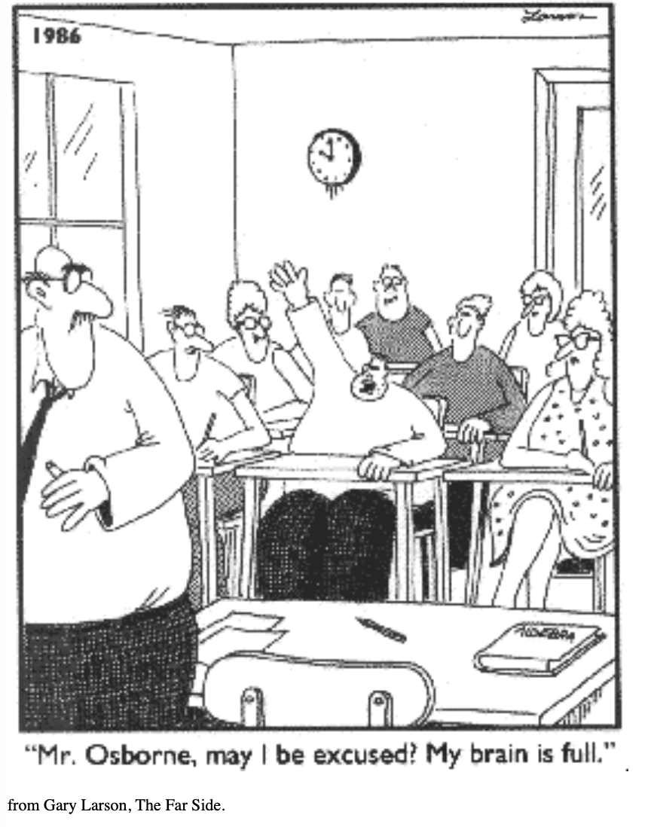
Serial Position Effect

Slide 42
Serial Position Effect

Slide 43
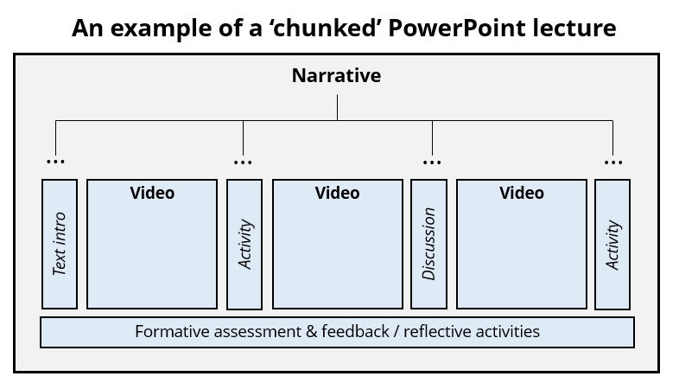
Serial Position Effect

Slide 44
You learn better when you wrestle with new problems before being shown the solution.
Notes:
Page 226

Slide 45
REFLECTION
How can you avoid the pitfalls of the serial position effect in the courses that you teach?

Slide 46
Myth
If I practice a single skill/concept until I am really good at it, I will be able to perfect the skill/concept

Slide 47
5.
Levels of Processing

Slide 48
“Learning is stronger when it matters, when the abstract is made concrete and personal.”

Slide 49
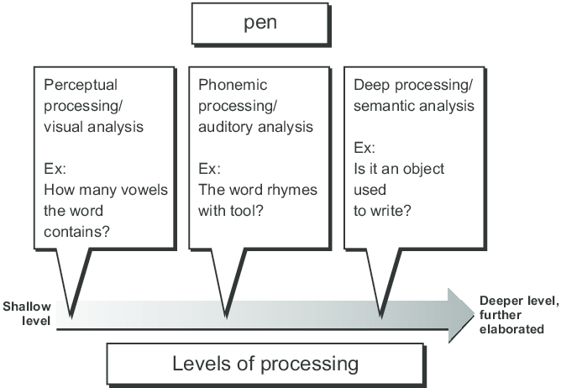

Slide 50
Baker/baker paradox
Gillian Cohen: the ease of remembering the name v. the profession
Thinking about a baker:
bread/scones
big ovens
cool hats
Thinking about names:
no actions, objects, or images
an arbitrary concept
no wealth of related knowledge or easily generated mental image to aid memory
Disconnected bits of information are hard to learn and remember.
Notes:
https://www.psychologytoday.com/us/blog/mental-mishaps/201002/large-mocha-without-name#:~:text=Remembering%20that%20a%20man's%20name,of%20the%20Baker%2Dbaker%20paradox.

Slide 51
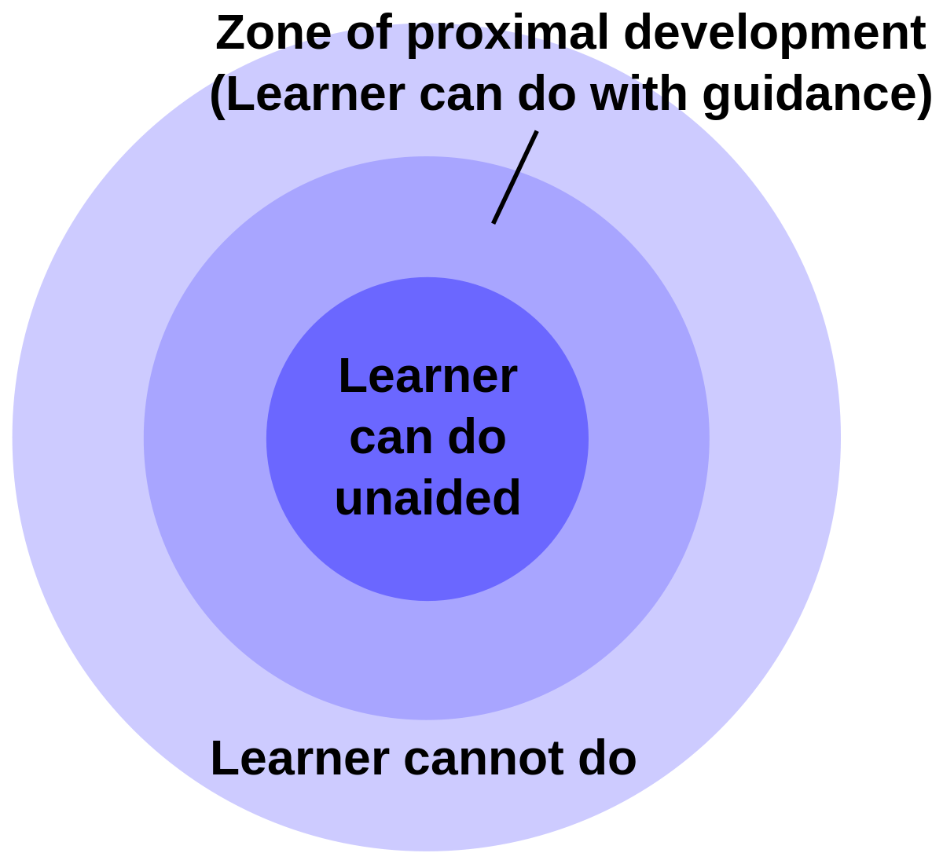

Slide 52
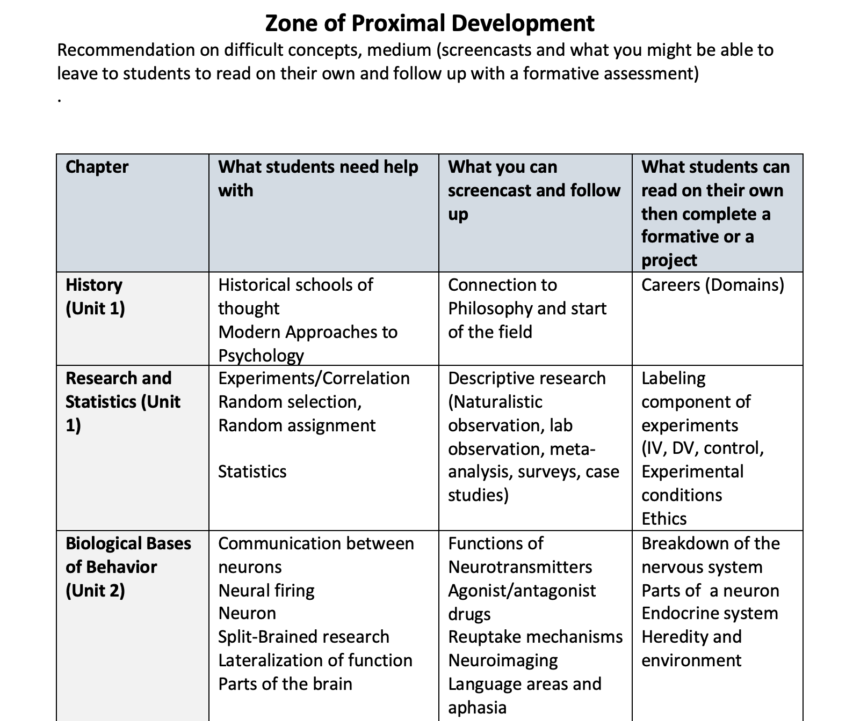

Slide 53
REFLECTION
How can you implement levels of processing into the course(s) that you teach?

Slide 54
Myth
Studying just before a major exam will provide the best result.

Slide 55
6.
DISTRIBUTED PRACTICE

Slide 56
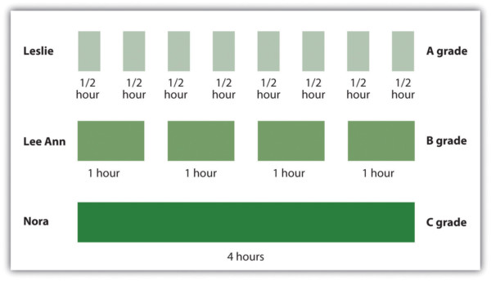
Distributed v. Massed Practice

Slide 57
Distributed v. Massed Practice

Slide 58
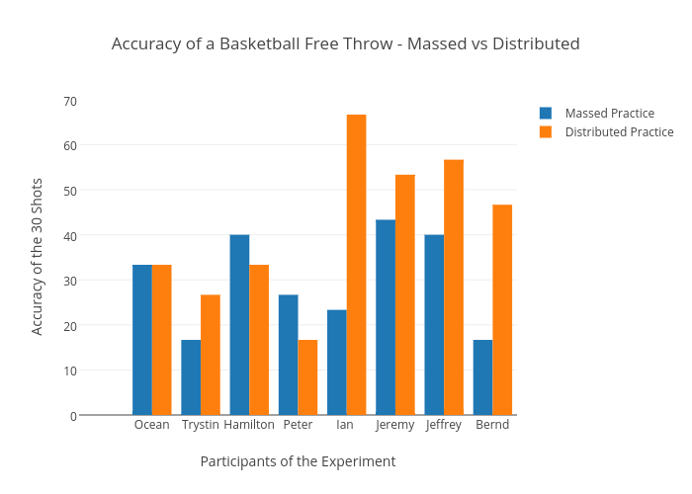
Distributed v. Massed Practice

Slide 59
Distributed v. Massed Practice
What can this look like in your classroom?
Evidence Based Teaching: https://www.evidencebasedteaching.org.au/distributed-practice-massed-practice/

Slide 60
Distributed v. Massed Practice
What can you do?
Administer frequent low stakes quizzes
(Case Study: Kathleen Mc. Dermott, Psychology Professor, Washington University at St. Louis) pages 236-238)
Incorporate formative assessments into daily practice
Have students self quiz often and quiz one another
Provide Specific Feedback for areas of Growth: Peer Grading (link to videos)
Notes:
Evidence Based Teaching: https://www.evidencebasedteaching.org.au/distributed-practice-massed-practice/

Slide 61
REFLECTION:
How can you implement distributed practice into the courses that you teach?

Slide 63
If you hand people the solution, they don’t need to explore how you got that solution.
~ Kathy Maixner
Notes:
Make it stick page 241

Slide 64
