Slide 1
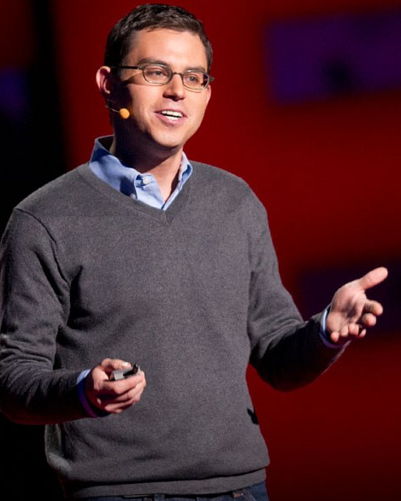
Memory Demo – Moonwalking With Einstein http://booksforpsychologyclass.weebly.com/

Slide 2
Directions: You will be shown each slide. Identify if each picture was shown on the previous power point (Y) or not (N).

Slide 3
Notes:
YES

Slide 4
Notes:
No

Slide 5
Notes:
YES

Slide 6
Notes:
NO

Slide 7
Notes:
NO

Slide 8
Notes:
NO

Slide 9
Notes:
YES

Slide 10
Notes:
YES

Slide 11
Notes:
NO

Slide 12
Notes:
YES

Slide 13
Notes:
YES

Slide 14
Notes:
YES

Slide 15
Notes:
NO

Slide 16
Notes:
YES

Slide 17
Notes:
NO

Slide 18
Notes:
YES

Slide 19
Notes:
NO

Slide 20
Notes:
YES

Slide 21
Notes:
NO

Slide 22
Notes:
NO

Slide 23
Notes:
NO

Slide 24
Notes:
NO

Slide 25
Notes:
YES

Slide 26
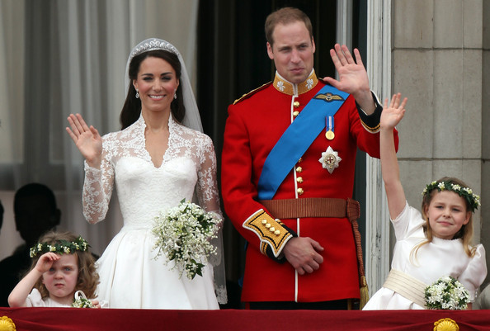
Notes:
YES

Slide 27
Notes:
NO

Slide 28
Notes:
YES

Slide 29
Notes:
NO

Slide 30
Notes:
NO

Slide 31
Notes:
NO

Slide 32
Notes:
YES

Slide 33
Notes:
YES

Slide 34
Notes:
NO

Slide 35
Notes:
NO

Slide 36
Notes:
YES

Slide 37
Notes:
NO

Slide 38
Notes:
YES

Slide 39
Notes:
NO

Slide 40
Notes:
YES

Slide 41
Notes:
YES

Slide 42
Notes:
NO

Slide 43
Notes:
NO – not in original PPT 1 but was presented in this PPT a few slides earlier

Slide 44
Notes:
YES

Slide 45
Notes:
NO

Slide 46
Notes:
NO

Slide 47
Notes:
NO

Slide 48
Notes:
YES

Slide 49
Notes:
NO

Slide 50
Notes:
YES

Slide 51
Notes:
NO

Slide 52
Notes:
YES

Slide 53
Notes:
YES

Slide 54
Notes:
NO

Slide 55
Notes:
YES

Slide 56
Notes:
YES

Slide 57
Notes:
YES

Slide 58
Notes:
NO

Slide 59
Notes:
YES

Slide 60
Notes:
YES

Slide 61
Notes:
NO

Slide 62
Notes:
YES

Slide 63
Notes:
NO

Slide 64
Misconception: If we cannot say what we know, it is not in our memory.
Counterintuitive Concepts in AP Psychology
Counterintuitive Finding: We have both declarative and non-declarative memories.
1. Declarative Memory: Information that you can tell others about
2. Non-Declarative Memory: Information that you can demonstrate by doing something.

Slide 65
More Memory Ideas!
For other similar exercises, check out the blog by the author, Joshua Foer.
http://blog.artofmemory.com/moonwalking-with-einstein-joshua-foer-1745.html

