Slide 1
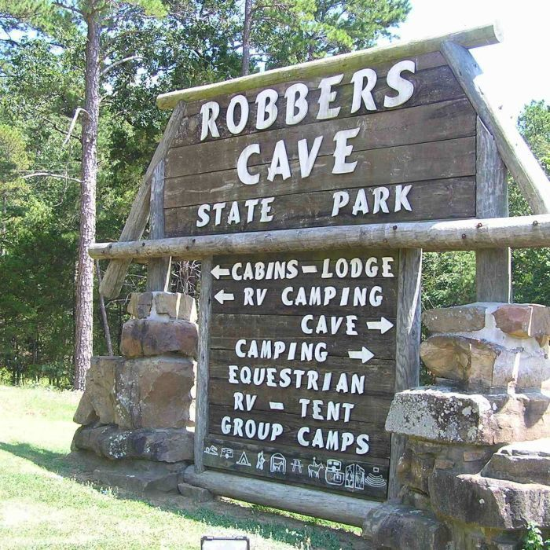
Sherif Robbers Cave Study
Muzafer and Carolyn Wood Sherif still images from the University of Akron Center for the History of Psychology
Notes:
http://collections.uakron.edu/cdm/ref/collection/p15960coll10/id/475

Slide 2
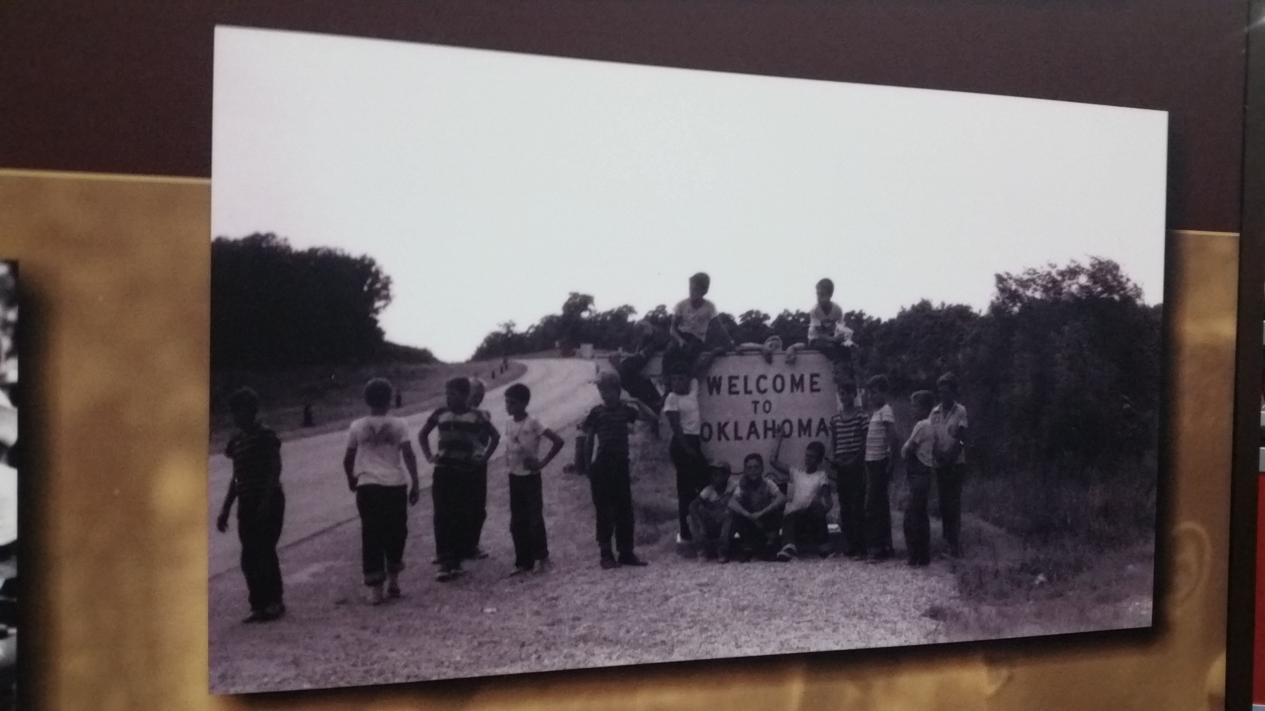
Sherif Robbers Cave Study

Slide 3
Sherif Robbers Cave Study

Slide 4
Sherif Robbers Cave Study

Slide 5
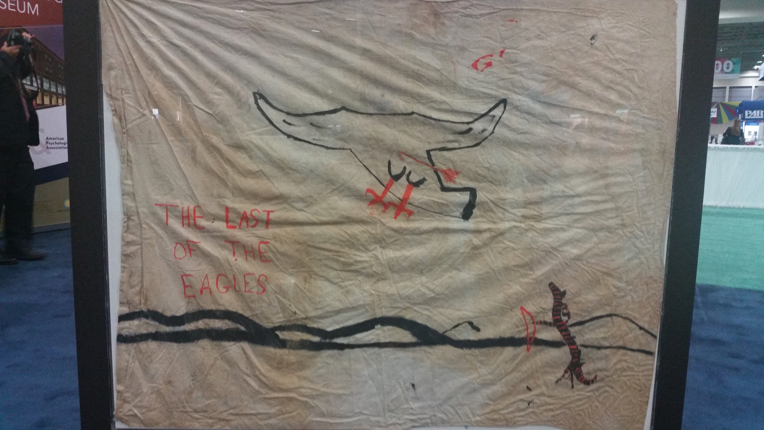
Sherif Robbers Cave Study

Slide 6
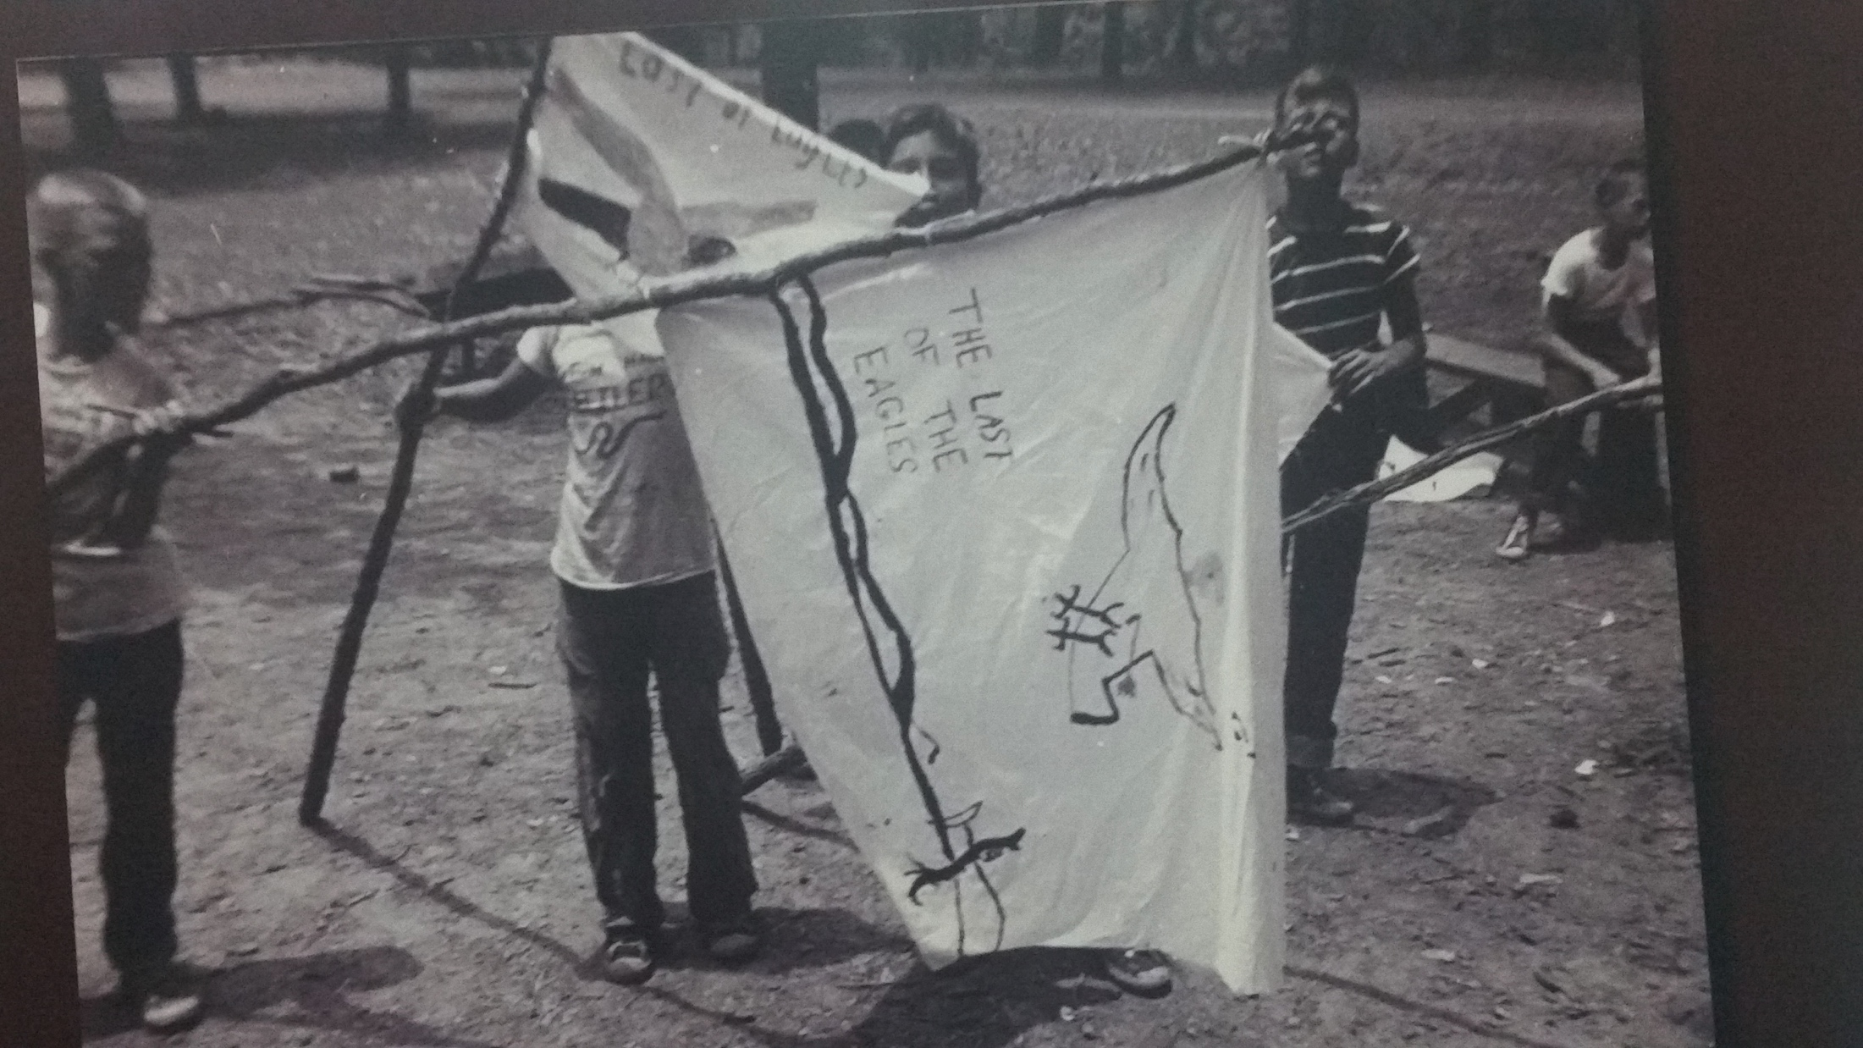
Sherif Robbers Cave Study

Slide 10
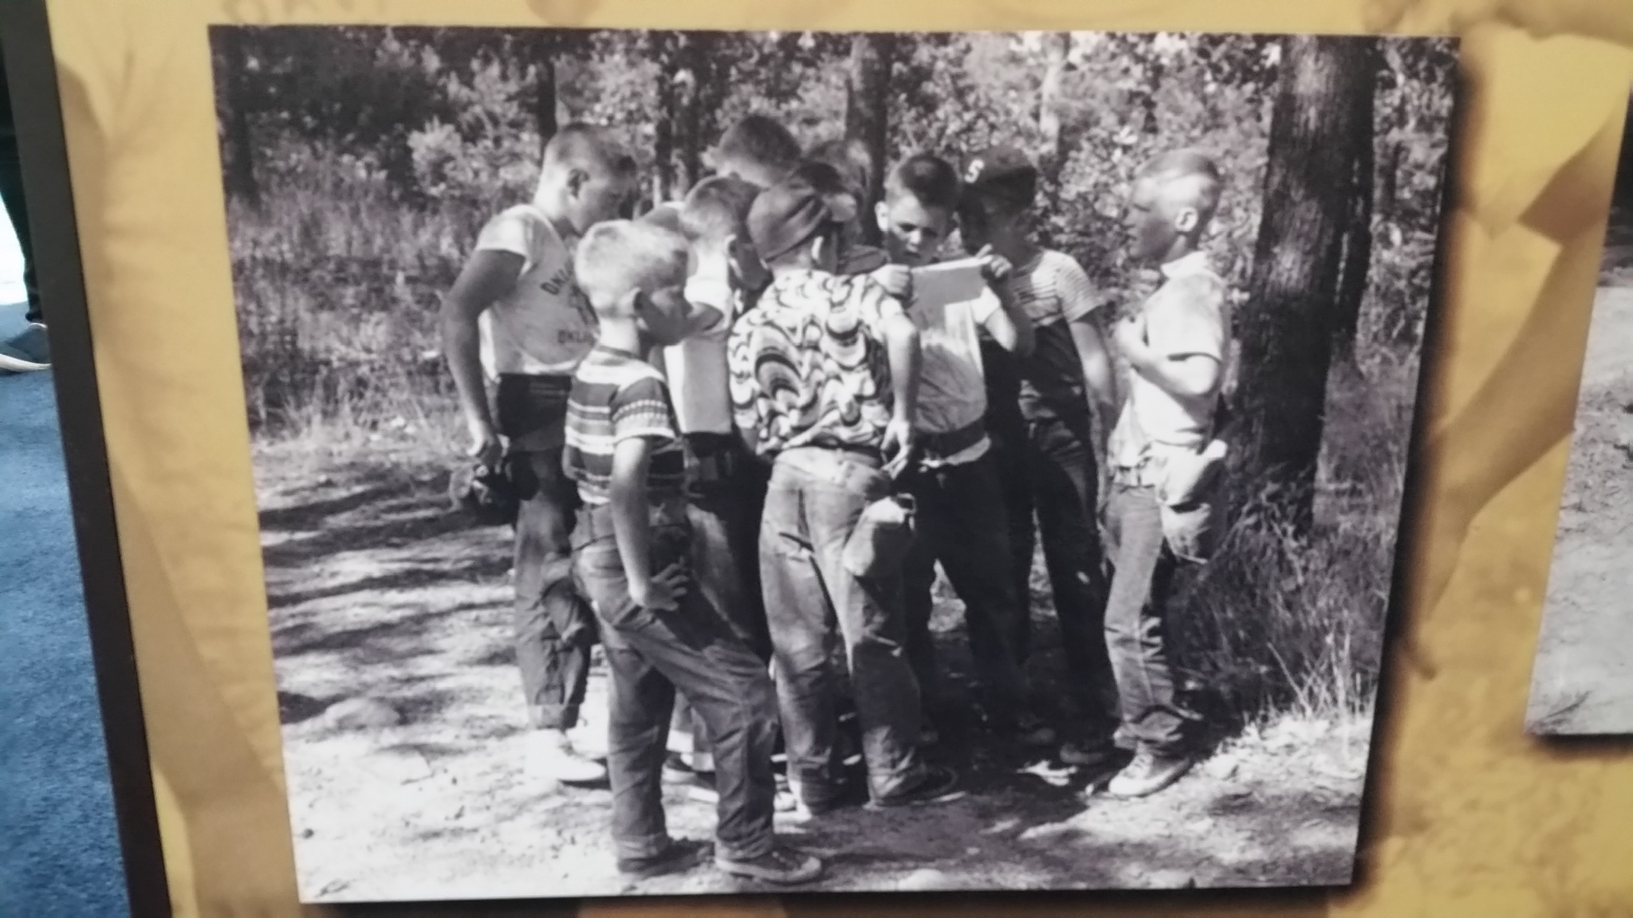

Slide 15
