Slide 1
Identifying
Facial
Expressions

Slide 3
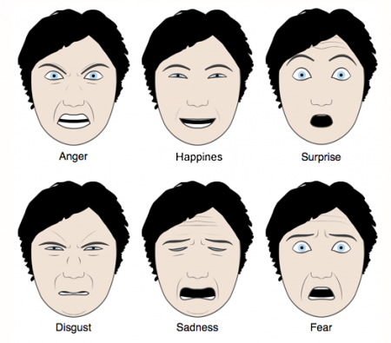
Six Universal Facial expressions.
Let’s investigate the characteristics of each of these facial expressions.

Slide 4
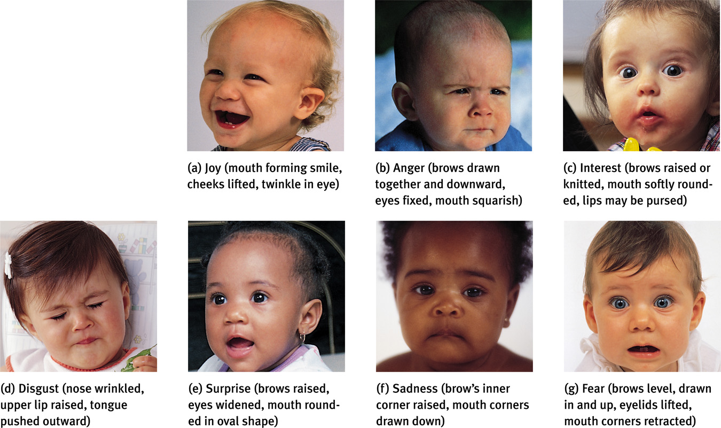
Infants Naturally Occurring Emotions

Slide 7
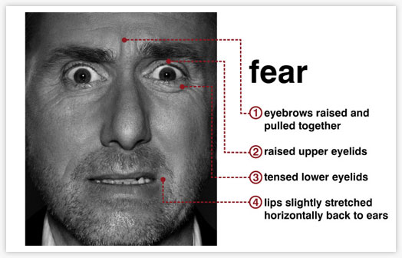

Slide 8
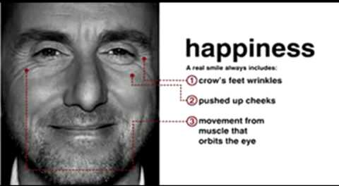

Slide 10
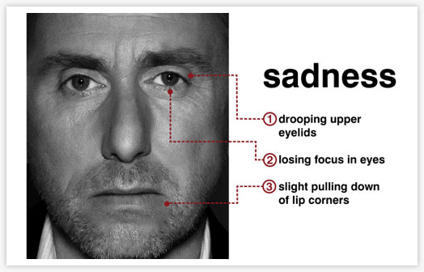

Slide 12
Notes:
anger

Slide 13
Notes:
surprise

Slide 14
Notes:
happiness

Slide 15
Notes:
sadness

Slide 16
Notes:
anger

Slide 17
Notes:
fear

Slide 18
Notes:
sadness

Slide 19
Notes:
happiness

Slide 20
Notes:
fear

Slide 21
Notes:
disgust

Slide 22
Notes:
happiness

Slide 23
Notes:
happiness

Slide 24
Notes:
fear

Slide 25
Notes:
Surprise

Slide 26
Notes:
sadness

Slide 27
Notes:
disgust

Slide 28
Notes:
surprise

Slide 29
Notes:
Fear, surprise

Slide 30
Which of these is a genuine smile?
Notes:
Right is the genuine smile

Slide 31
Which two facial expressions are displayed here?
Notes:
Sad eyes, neutral face

Slide 32
Which two facial expressions are displayed here?
Notes:
Surprise and Fear

Slide 33
Identify the two different facial expressions this woman is displaying
Notes:
Happiness and surprise

Slide 34
Microexpressions Test
http://www.microexpressionstest.com/micro-expressions-test/

Slide 35
http://www.bbc.co.uk/science/humanbody/mind/surveys/smiles/index.shtml
BBC Spot the Fake Smile Test

Slide 36
Duchene Smile:
Natural sincere smile that uses different facial muscles than fake smile
Involves not only upward turning of corners of mouth, but drooping of eyelids and crinkling of corners of eyes.
Notes:
The individual in the following slides suffered a stroke to the area of the motor cortex that is used to make a fake smile, but the area of the cortex in charge of a sincere (Duchene) smile was NOT damaged.

Slide 37
Notes:
The individual in the following slides suffered a stroke to the area of the motor cortex that is used to make a fake smile, but the area of the cortex in charge of a sincere (Duchene) smile was NOT damaged.

Slide 38
Notes:
Sincere smile - The individual in the following slides suffered a stroke to the area of the motor cortex that is used to make a fake smile, but the area of the cortex in charge of a sincere (Duchene) smile was NOT damaged.

